Slide 1
Uncommon Commonalities
We are the same in our differences

Slide 2
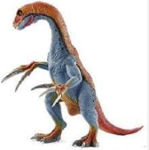
Find an object on the table that stands out and says Grab Me!

Slide 3
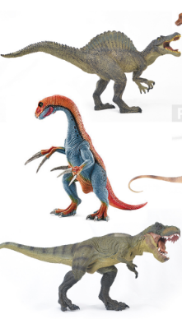
Find two other people with objects most like yours

Slide 4
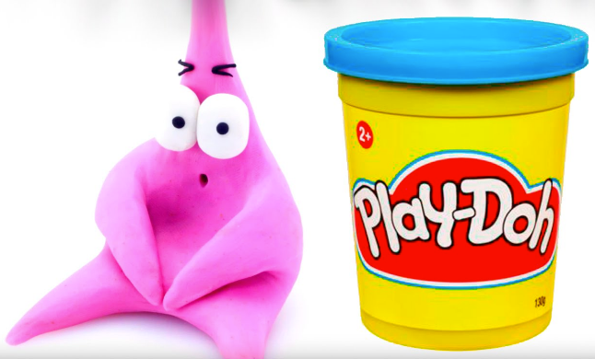
What connection(s) might you make between your object and STEM Literacy?

Slide 5
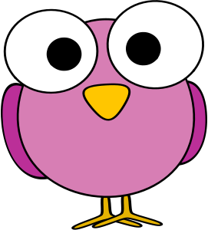
How are you different? What do you have in common?

Slide 6
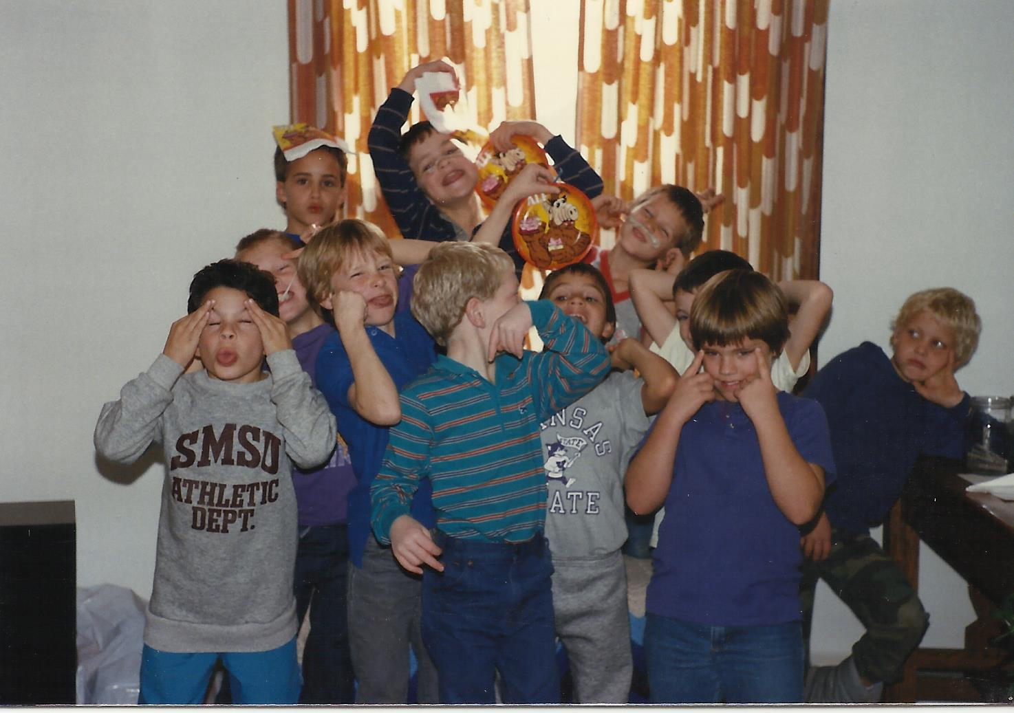
Create a name for your team based upon the most uncommon things all team members have in common.

