Slide 1
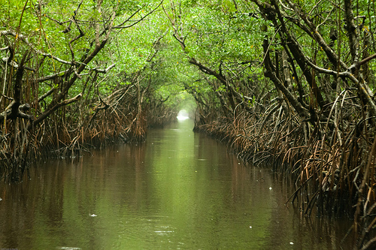
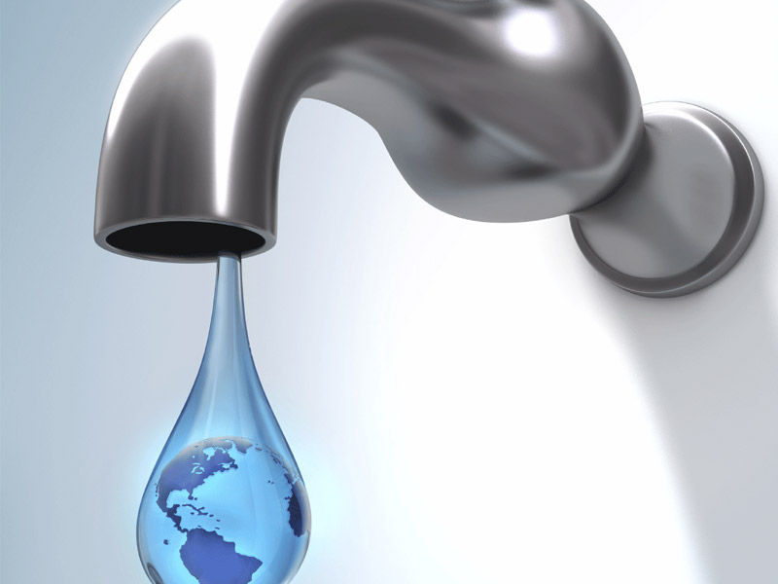
Science time
1
Everglades Town Hall
Using scenario-based assessments to frame issue-based learning
2
Model my Water Usage
Collecting and using data to enhance science learning

Slide 2
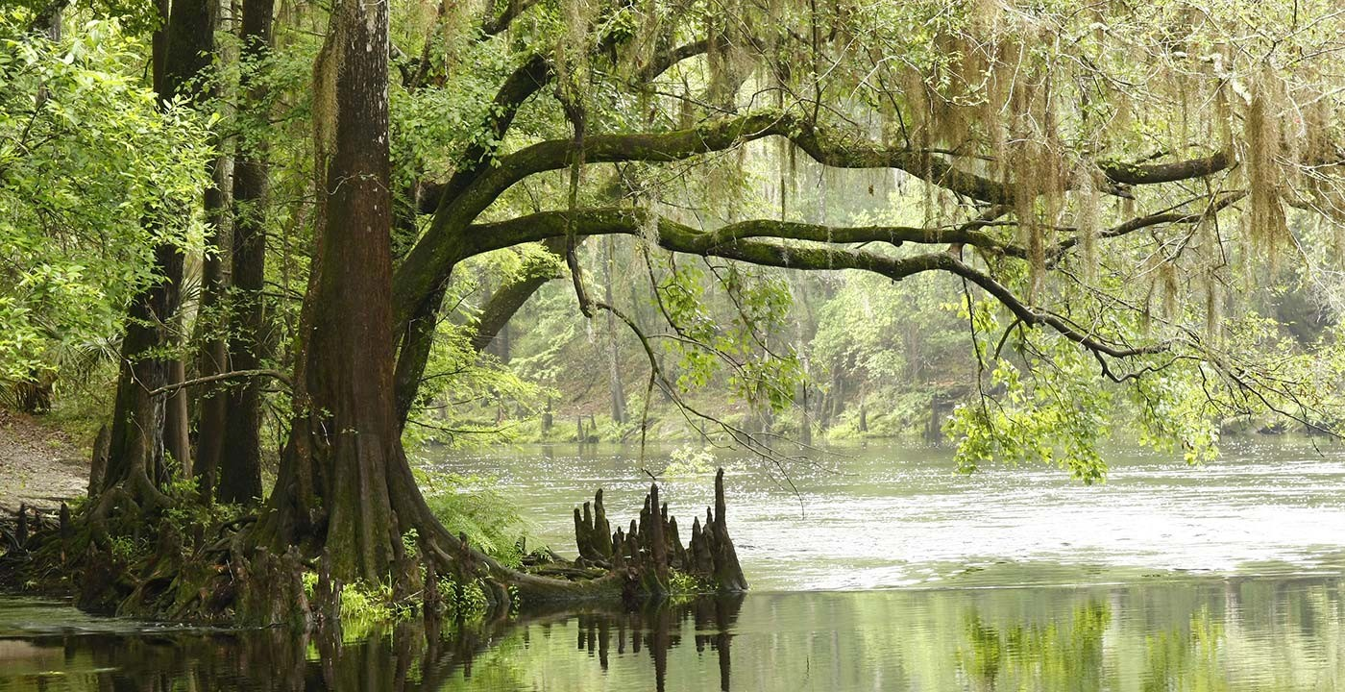
Using scenario-based assessments to frame issue-based learning
Formative & Summative

Slide 3
READ
the Everglades scenario

Slide 4
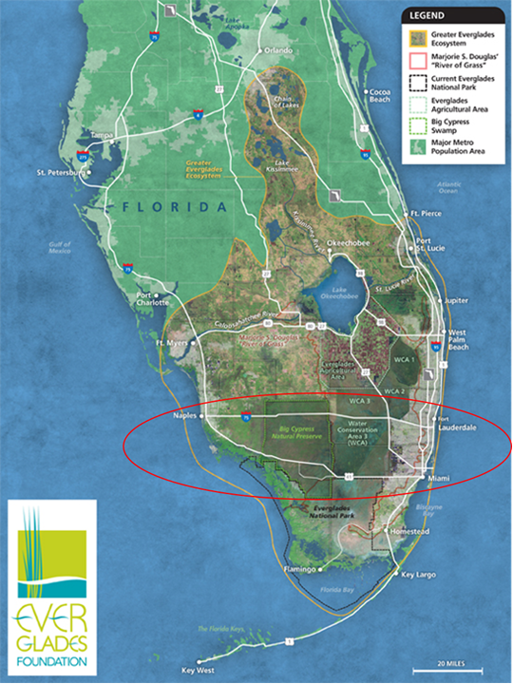
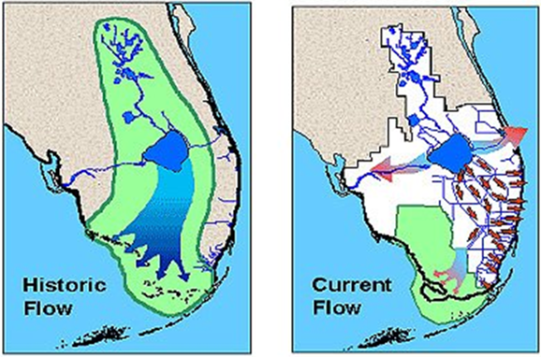
Everglades water flow – visual resource

Slide 5
Everglades City
Water debate

Slide 6
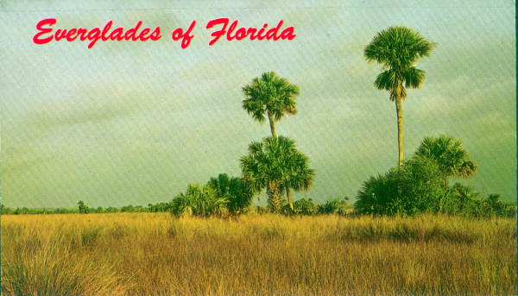
Each teacher pair was assigned a role
Develop a 2 minute argument to deliver to town hall
Objective: Secure as much water as you can for your constituency

Slide 7
Speaker: *introduce your constituency (i.e., builders)
*lay out your argument to gain as much water for your constituency as possible (2 minutes)
Townspeople: *take note of the types of information used by each speaker to argue that they should get the water.
*that information will later enable you to appropriately apportion water to each constituent

Slide 8
M & Ms
Blue: Each group has 20 water units that they are responsible for awarding to the constituents they feel most deserving (NOT self)
Green: Each group can make 2 rebuttals to statements made by other constituents

Slide 9
Sufficient information?

Slide 10
What types of information are necessary to make a truly informed decision about how water should be appropriated?

Slide 11
Are there any constituents going unrepresented?

Slide 12
Ethical,
Political & Cultural concerns
Science
Ideas
Science
Practices

Slide 13
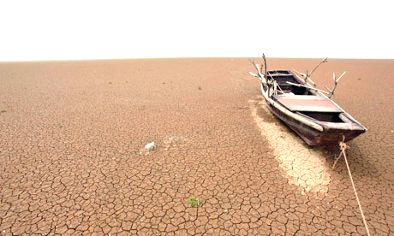
Will there be water for us?
Objectives
Understand Water Scarcity as an Issue
Model Water in Environmental Systems (Progression)
Navigate overlap in modeling: Mathematics, Science, & English
See “Modules” at RI2.Missouri.edu to access Water Scarcity Unit and other units of science instruction contextualized in Socio-Scientific Issues
Photo: http://goemaw.com/forum/index.php?topic=29718.25

Slide 14
Model my Water Usage

Slide 15
Model my Water Usage
Objective: The student will understand how scientists ask questions, analyze and represent data, and important findings with the public to help direct policy

Slide 16
Science Publications
Introduction is used to provide background information that logically builds to a research question(s).
Methods section is used to tell the reader how data was collected and analyzed (repeatable).
Results section includes the results of the analysis, as well as graphic representation of the data.
Discussion section discusses the findings, limitations, and future directions for research/policy.

Slide 17
Research Questions
Each individual will write their 3 best questions (most interesting/important for society), each with one sentence of logic that sells each as an important question.

Slide 18
Research Questions
What makes a good question? – groups make list of characteristics using google doc – populates the overhead projector screen so all can see.

Slide 19
Research Questions
What makes a good question? – groups make list of characteristics using google doc – populates the overhead projector screen so all can see.
Have real answers
Are testable
Have a hypothesis that is falsifiable
Are interesting
WATCH: Nobel Prize winner discusses what makes for Nobel prize-winning research questions
http://www.nobelprizeii.org/videos/makes-good-scientific-question-2/

Slide 20
Research Questions
Each group will provide feedback on each members’ questions and logic, select their 3 best questions w/logic to represent their group.
Each group will post their 3 questions with corresponding logic for each on google doc

Slide 21
Research Questions
Each group reads the list of questions/logic on google doc overhead projector and ranks their top 5. (5 for best of top 5, 1 for worst)
The top three vote getting questions become the questions that will be answered by all teams for this PD session.

Slide 22
e.g., How does water consumption (cups drunken) vary across students?
By answering this question, scientists can determine and average of water drunken and standard deviation, so they can identify those outside the normal range, interview them, and determine what factors are leading to their low/high usage of water – information that can be used to make drinking recommendations to the public, in light of the FDA’s daily recommended water intake for humans.

Slide 23
Research Questions
Any objections/discussions before settling on top 3 to focus our research?

Slide 24
Introduction
Each team writes a 3 sentence introduction that logically leads to the value/importance of the 3 questions. (sales pitch)
- groups share 3 sentence introduction using google

Slide 25
Methods
Each group writes a concise three sentence methods section to tell the reader how data was collected and analyzed.
groups share 3 sentence introduction using google doc
16 Cups = 1 gallon
Toilet flush = 3.6 gal/flush http://www.home-water-works.org/indoor-use/toilets
Sink minutes = 1.1 gal/min http://www.home-water-works.org/indoor-use/faucet
Shower minutes = 2.1 gal/min http://www.home-water-works.org/indoor-use/showers

Slide 26
Results
Each group writes a concise three sentence results section to tell the reader how data was analyzed and represented.
- groups share 3 sentence introduction using google doc

Slide 27
Discussion
Discuss your findings (results), limitations of your study, and future directions for research/policy
- groups share 3 sentence introduction using google doc

Slide 28
shower
Psychologist Doug McKenzie-Mohr describes one such study in his book "Fostering Sustainable Behavior." A college gym's shower room displayed a prominent sign urging students to conserve water by turning off the shower while they soaped up. Only 6% did so initially. But when researchers planted an accomplice who shut off his water midshower, 49% of students followed suit. When there were two accomplices, compliance jumped to 67%, even though the accomplices didn't discuss their actions or make eye contact with other students.
https://www.wsj.com/articles/SB10001424052748704575304575296243891721972

Slide 29
There are other “taboo” ways that aren’t “on message” either: Urinating in the shower, turning off the water to your toilet and flushing it with used water instead, not washing your jeans or underwear just because you wore them for a few hours. And, there’s this: “Shower with a friend,” Chaiken says. “It may not save a ton of water, but it is a lot of fun.”
http://whyflush.com/

Slide 30
Students’ HW
Go back to your original questions or write a new one that we haven’t already analyzed. Use 3 sentences to write a logical introduction to the question, as well as methods, results, and discussion sections to communicate your findings.

Slide 31
Pros and Cons of this strategy for classroom use.
Suggestions?
Lingering questions?
How can you use this strategy for the different classes that you teach?
What topics can you do this for in your class?

Slide 32
Discussion

Slide 33
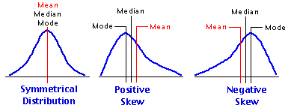

Slide 34
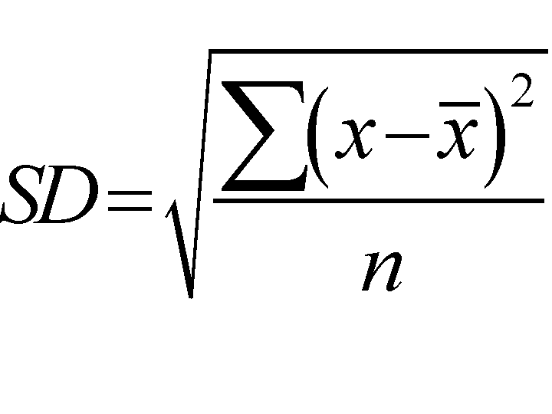
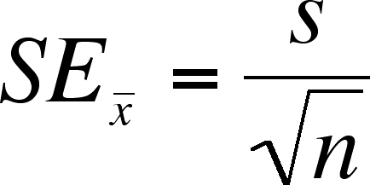
The standard deviation, or SD, measures the amount of variability or dispersion for a subject set of data from the mean,
The standard error of the mean, or SEM, measures how far the sample mean of the data is likely to be from the true population mean.

