Slide 1
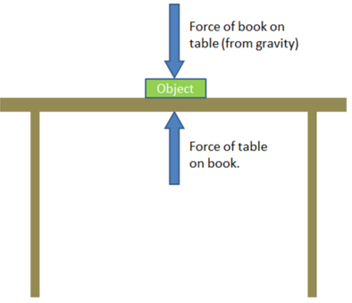
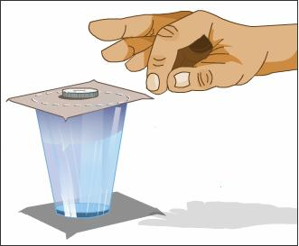
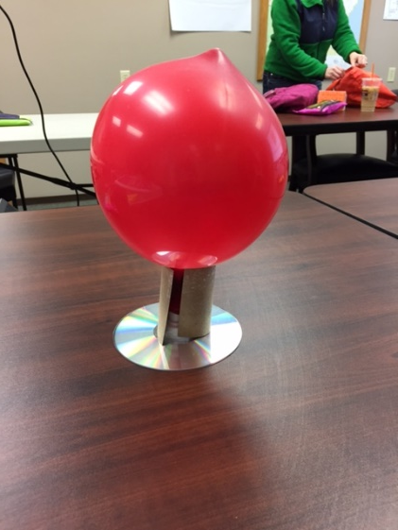
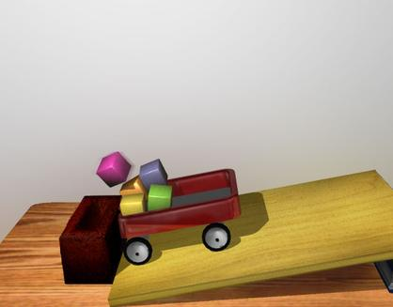
Flurry of Forces
Colleen Freeman

Slide 2
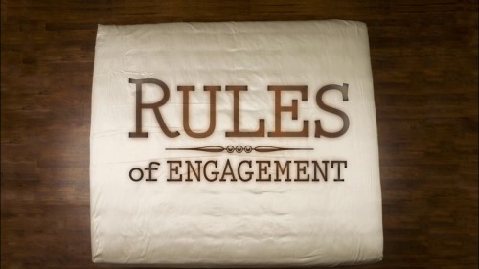
Flurry Steps
BEFORE PICKING ANYTHING UP!!!
Write name and number of station and list materials.
Read the directions.
Draw a model of your prediction.
NOW you may do the activity.
Record your observations
Attempt to explain the reason.

Slide 3
Experience
Last year did this activity before introducing motion, speed, acceleration
This year after motion, speed, acceleration and before Newton’s Laws

Slide 4
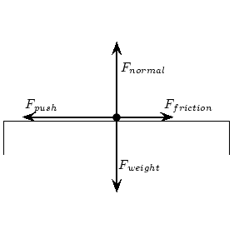
Literacy Wrap Up
Write a story
Write about the flurry activities (or a portion of them) and how forces are involved
Draw and label force vectors involved in several of the flurry activities

Slide 5
Jot Thought
How might you use this in the classroom?
Any suggestions?
Did you have fun?

